Slide 1

The principles of
animation
Tutor : Liyan Chen
Email: chenliyan@xmu.edu.cn

Slide 2
Chapter 6
Character design

Slide 3
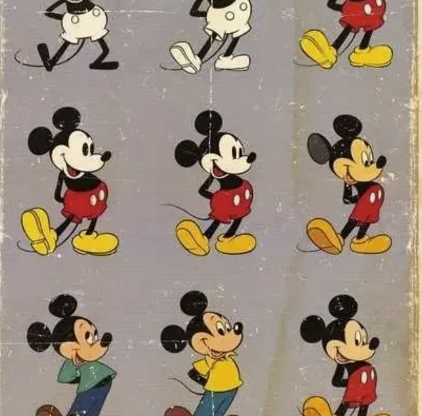

Slide 4

1.Character Design Process
1.1 Characters Checklist
The content includes: the character of the character, background information (region, nationality, sex, age, body shape, character, occupation, etc.) , the relationship with other characters, positive or negative characters, character action characteristics, special requirements of clothing and props, living habits, where they appear, what tasks to accomplish in an animated scene.

Slide 5
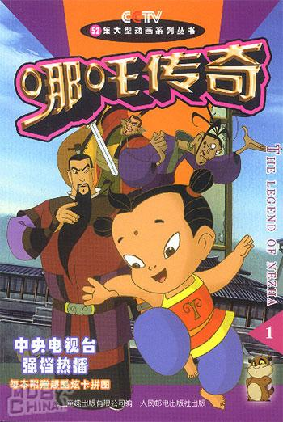

Slide 6
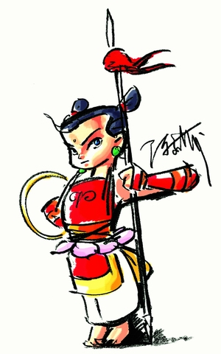
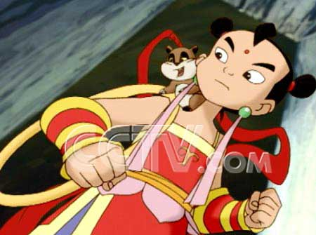

Slide 7
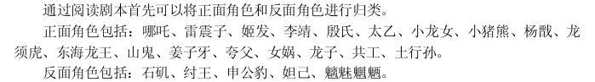
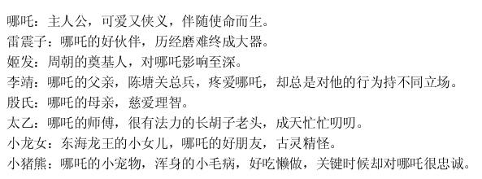

Slide 8
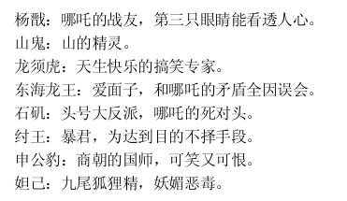

Slide 9
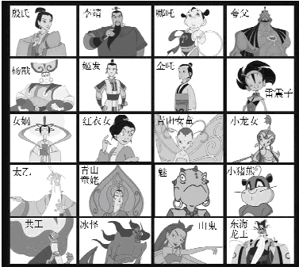

Slide 10
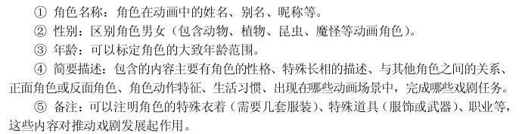

Slide 11
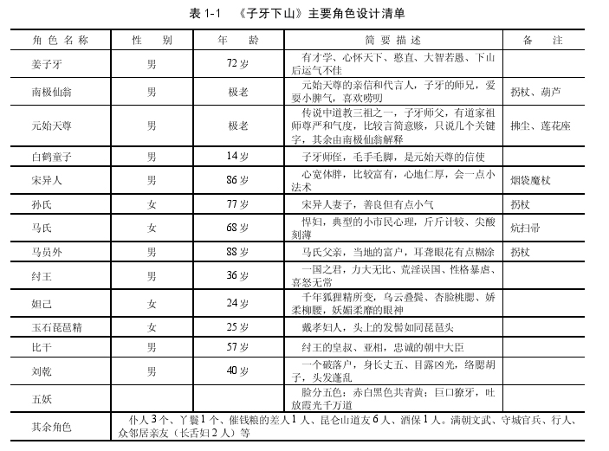

Slide 12
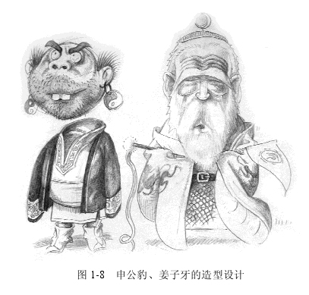

Slide 13
1.2 Gather material
In the beginning of the animation character design process, first of all, to collect some of the modeling-related material and some background information.

Slide 14

An analysis of the roles in the Lion King

Slide 15
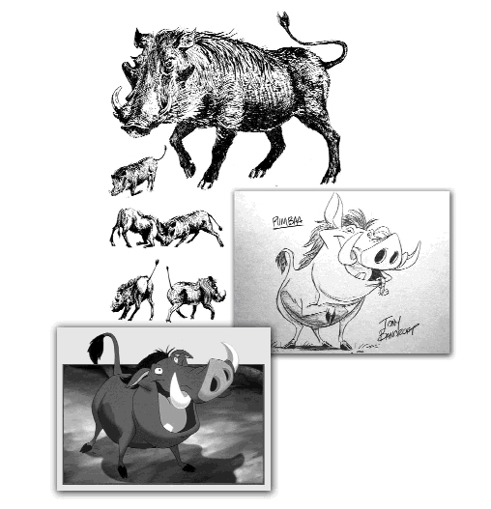
An analysis of the roles in the Lion King

Slide 16
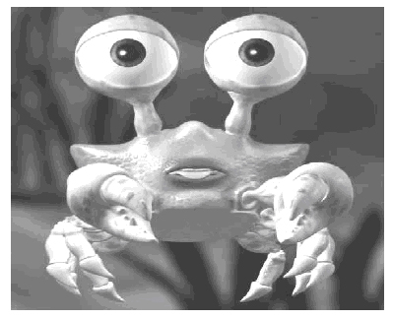
Role Analysis of three-dimensional animation short film the story of the Beach

Slide 17
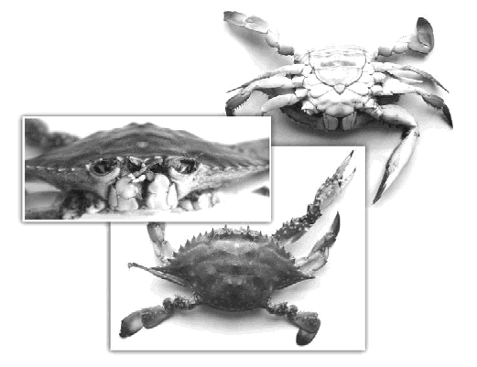
Role Analysis of three-dimensional animation short film the story of the Beach

Slide 18
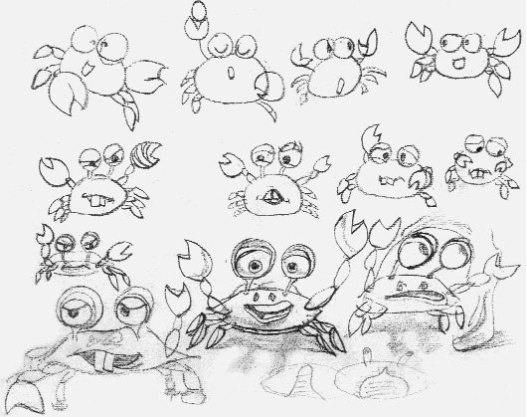
Role Analysis of three-dimensional animation short film the story of the Beach

Slide 19
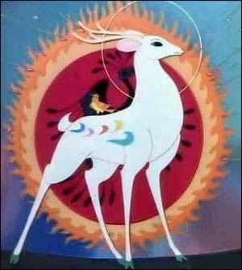
An analysis of the role of nine-color deer

Slide 20
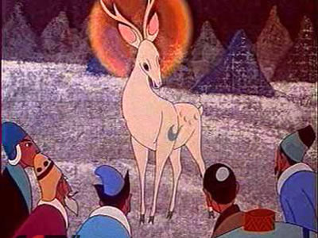
An analysis of the role of nine-color deer

Slide 21
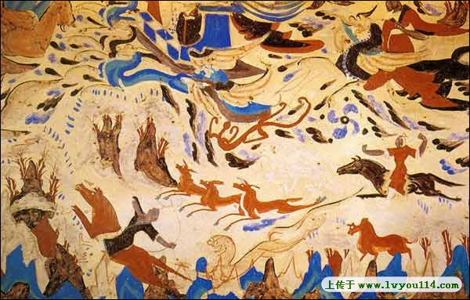
An analysis of the role of nine-color deer

Slide 22
1.3 Character setting
In order to move the reader, personalities on their roles should be prominent as far as possible. In particular, the modelling design of the main character must have distinct personalities.

Slide 23
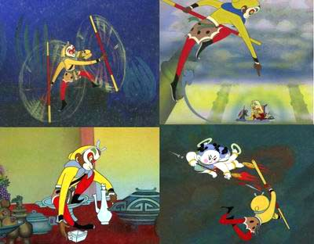

Slide 24
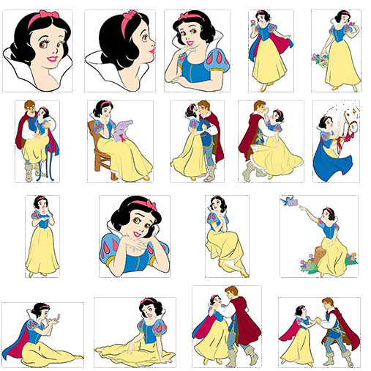
An analysis of the roles in Snow White

Slide 25
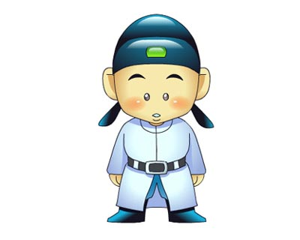

Slide 26
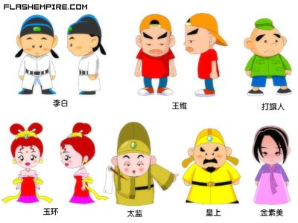
The original character painting of Li Bai in the story of a liar

Slide 27
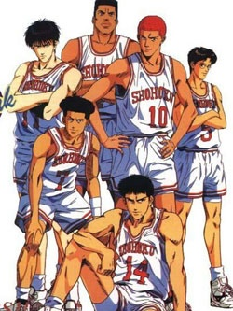
2. the classification of the character image
2.1 realistic classes

Slide 28
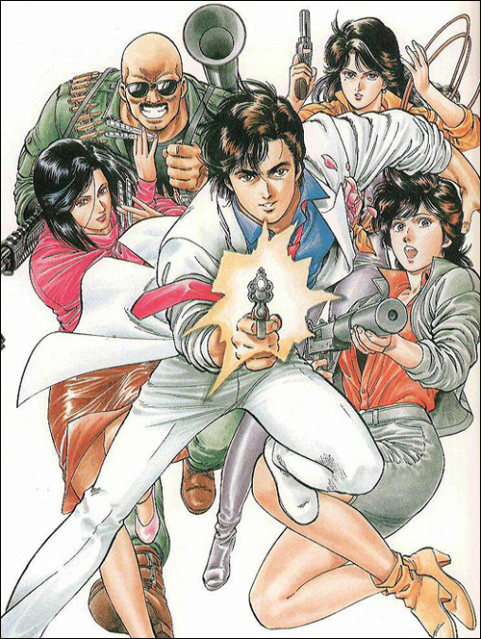

Slide 29
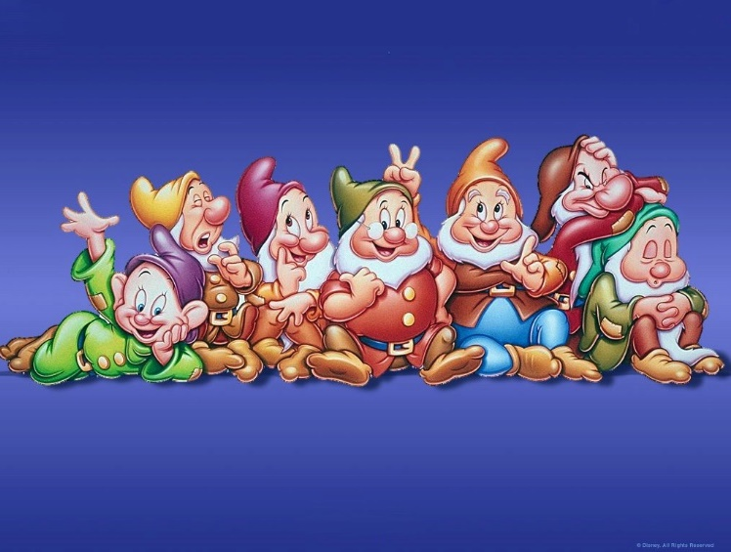
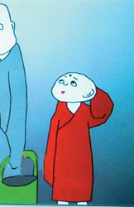
2.2 exaggerated morphing classes

Slide 30
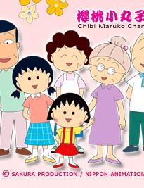
1.3 symbolic classes

Slide 31
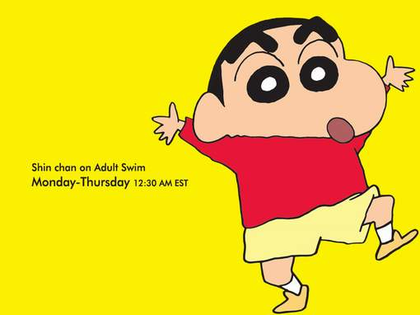

Slide 32
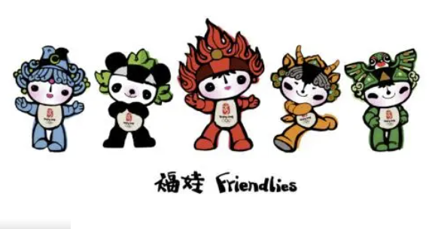

Slide 33
3. The animation image design modeling method
In the clear animation image of the design positioning, we will enter the specific modeling rendering. How to use their own mental image of the concept of performance, which is often a novice more headache.

Slide 34
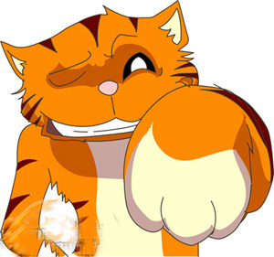
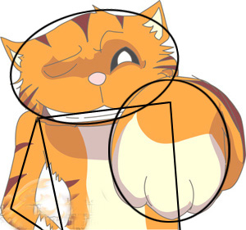
3.1 combination of geometries

Slide 35
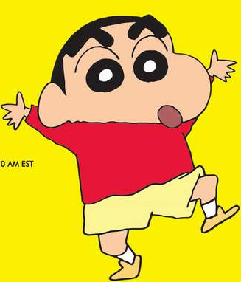
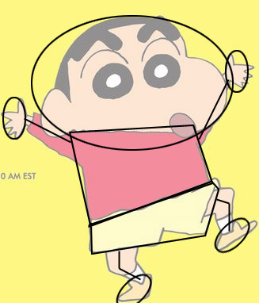

Slide 36
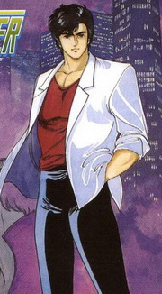
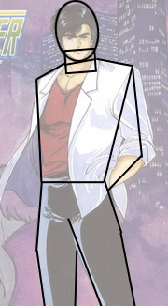

Slide 37
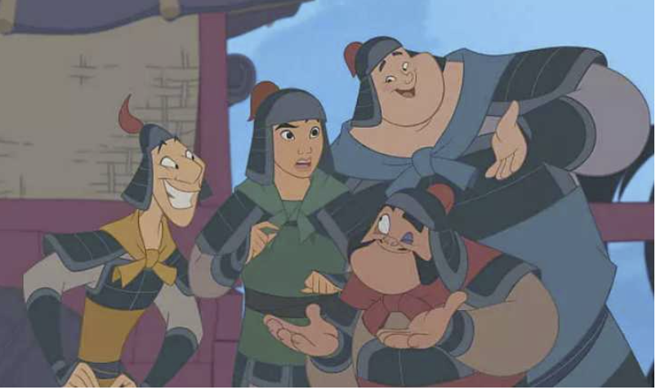
3.2 exaggeration

Slide 38
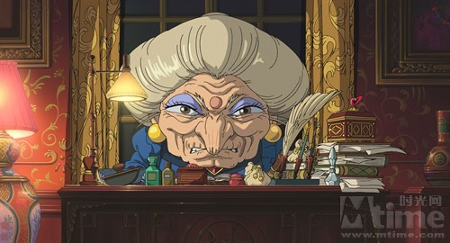

Slide 39
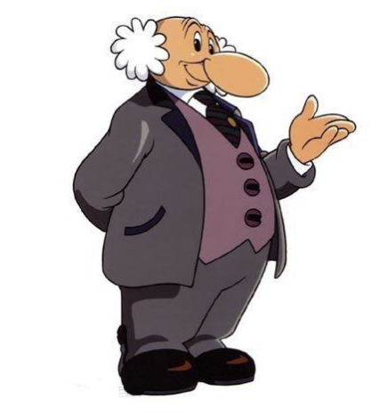

Slide 40
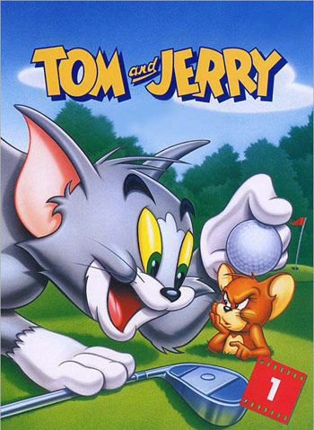
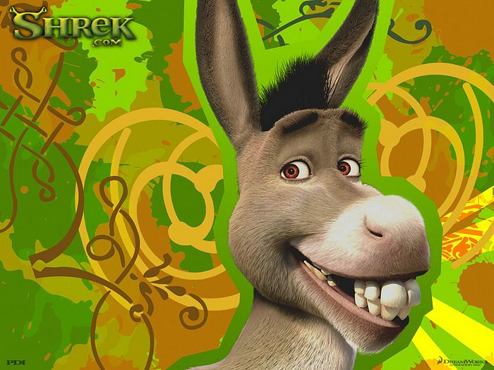
3.3 anthropomorphic treatment

Slide 41
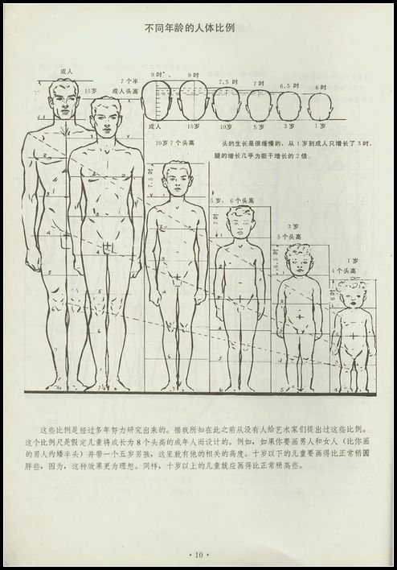
4.the character image design
4.1 body size

Slide 42
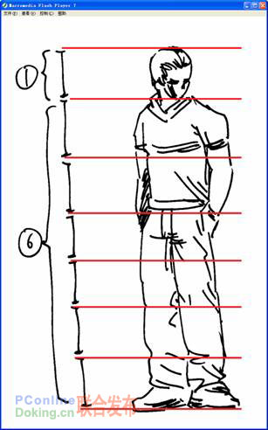
4.1 Realistic body proportions

Slide 43
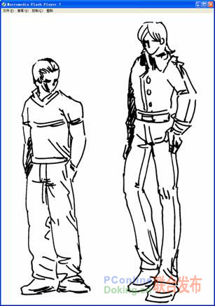

Slide 44
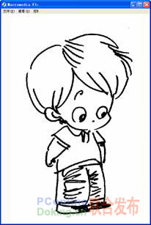
4.2 Q characters

Slide 45
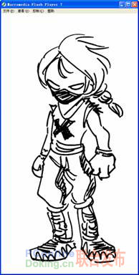
4.3 Half Q characters

Slide 46
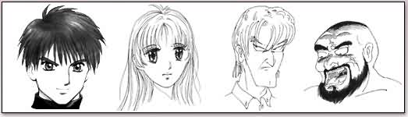
portraits of different ages
In order to accurately introduce all the characters in the story to the readers, we should master the drawing methods of different ages and genders.

Slide 47
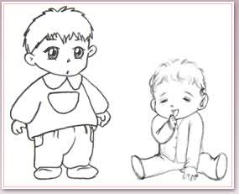
Baby: Chubby, rounded, the head appears particularly large, wide forehead, can not see the neck, body length is equal, feet to, short.

Slide 48
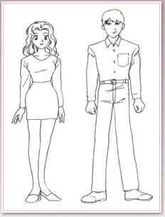
Young Women: the line is more delicate, slightly oblique shoulders, the overall curve.
Young men: strong lines, broad shoulders, fan-shaped chest, waist than shoulder narrow, thick neck, feet big.

Slide 49
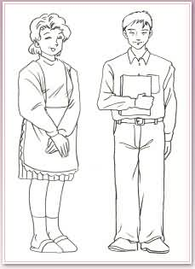
Middle-aged women: than young women slightly fat, slightly smaller eyes, thick ankles.
Middle-aged men: slightly fatter than young men, more sparse hair.

Slide 50
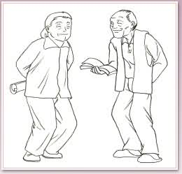
Older women: hunched over, shoulders slightly sloping, knees slightly bent.
Old Man: bent bent bent back, feet apart, a bit bent, narrow shoulders, if painted on crutches will be more old.

Slide 51

How to draw different ages People’s facial features:
Infants: the facial features of infants are concentrated in the lower half of the face 1/2 part.

Slide 52

Child: Big Eyes, small mouth and nose. The eyes are below 1/2 of the face, the curve of the chin is round, and the eyes are far from the eyebrows.

Slide 53

Female: eyes are roughly 1/2 of the way up to the face. The bigger the eyes, the softer the lines of the lips, the brows, the chin, the more feminine.

Slide 54


Slide 55


Slide 56


Slide 57


Slide 58


Slide 59


Slide 60


